Slide 1
Graphic Design 1

Slide 2
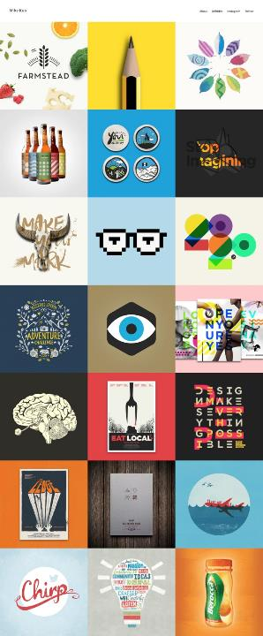
What is Graphic Design?
Graphic design is a craft where professionals create visual content to communicate messages.

Slide 3
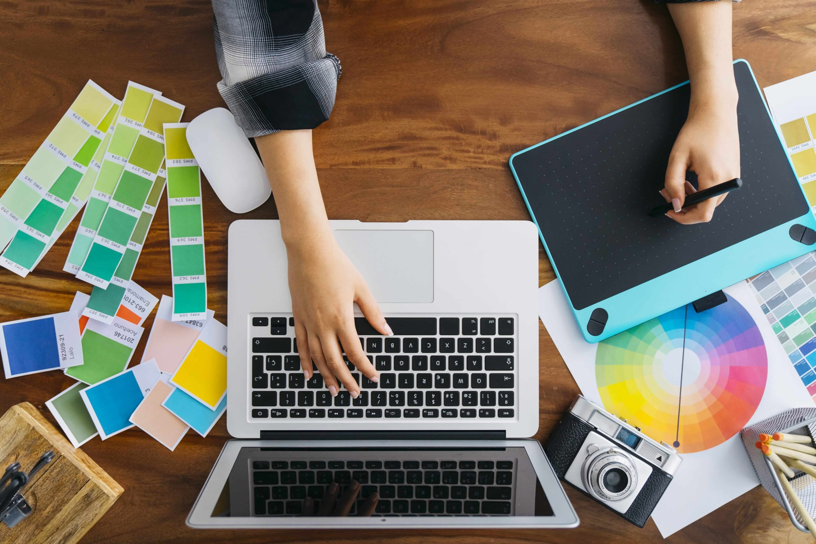
What is Graphic Design?
Graphic design is the creation of visual compositions to solve problems and communicate ideas through typography, imagery, color and form.

Slide 4
What is Graphic Design?
By applying visual hierarchy and page layout techniques, designers use typography and pictures to meet users’ specific needs and focus on the logic of displaying elements in interactive designs, to optimize the user experience.

Slide 5
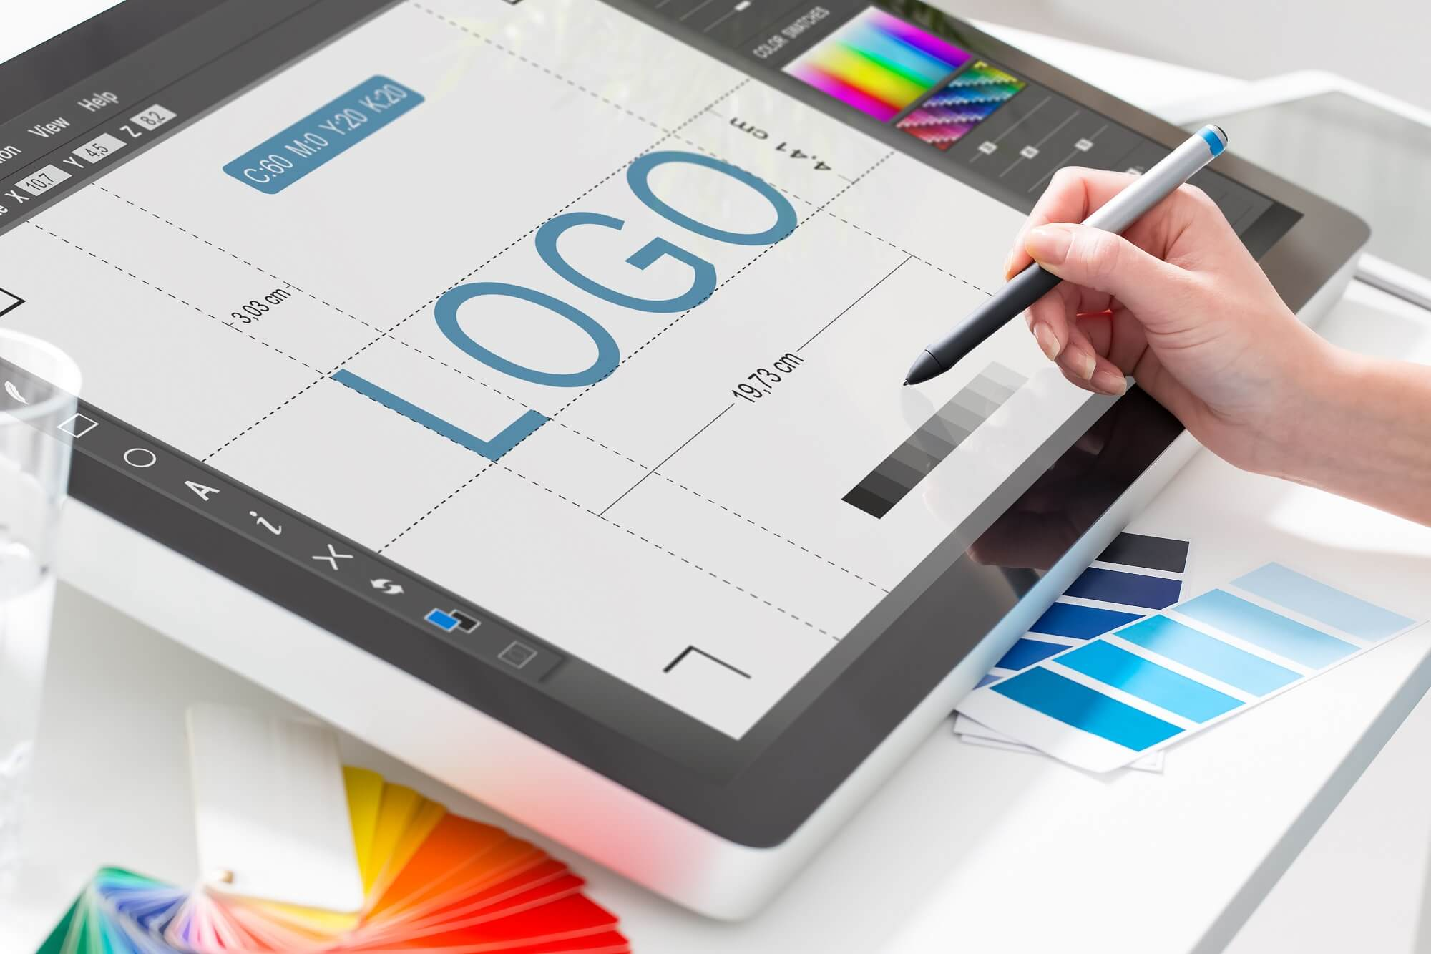
Graphic Design is about Molding the User Experience Visually
It’s a term that originated in the 1920s’ print industry. It continues to cover a range of activities including logo creation. Graphic design in this sense concerns aesthetic appeal and marketing.

Slide 6
“Design is a solution to a problem. Art is a question to a problem.”
— John Maeda, President of Rhode Island School of Design

Slide 7
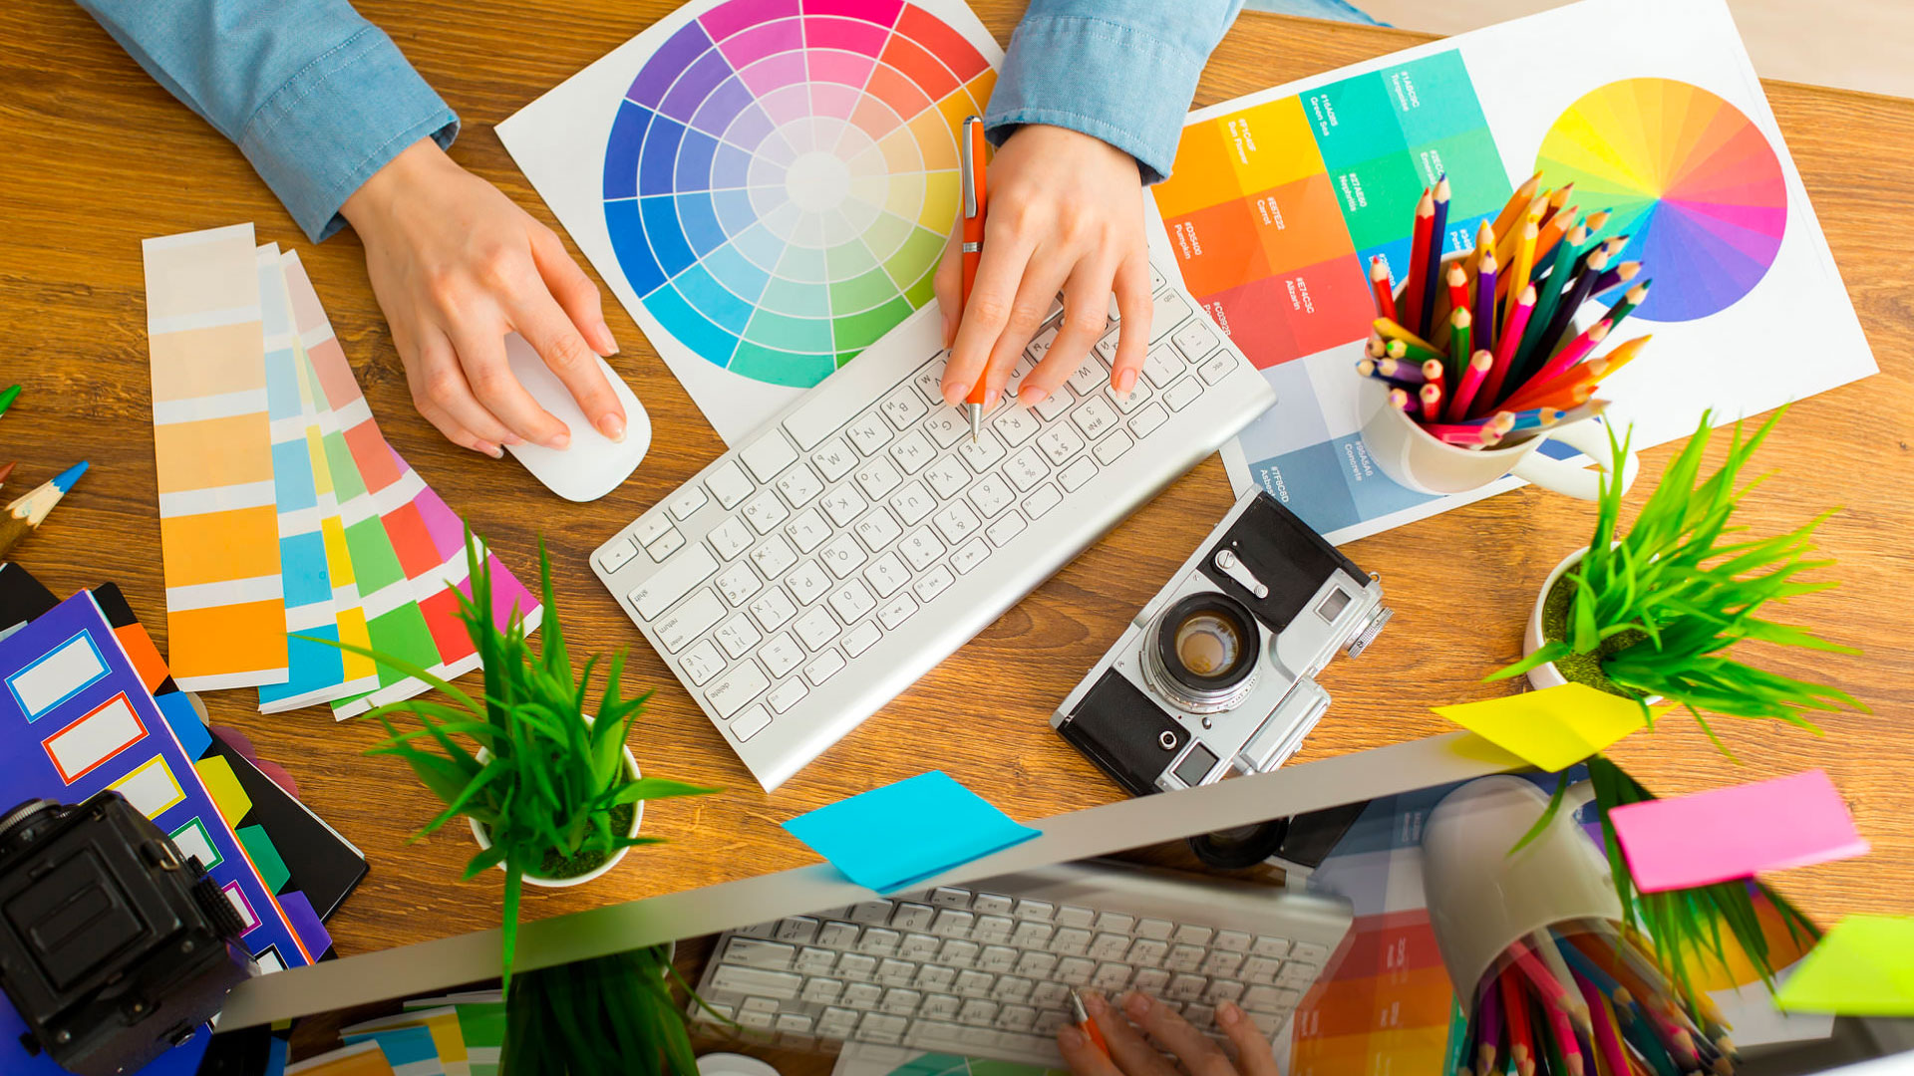
Graphic Design is Emotional Design
As a graphic designer, you should have a firm understanding of color theory and how vital the right choice of color scheme is. Color choices must reflect not only the organization but also users’ expectations.

Slide 8
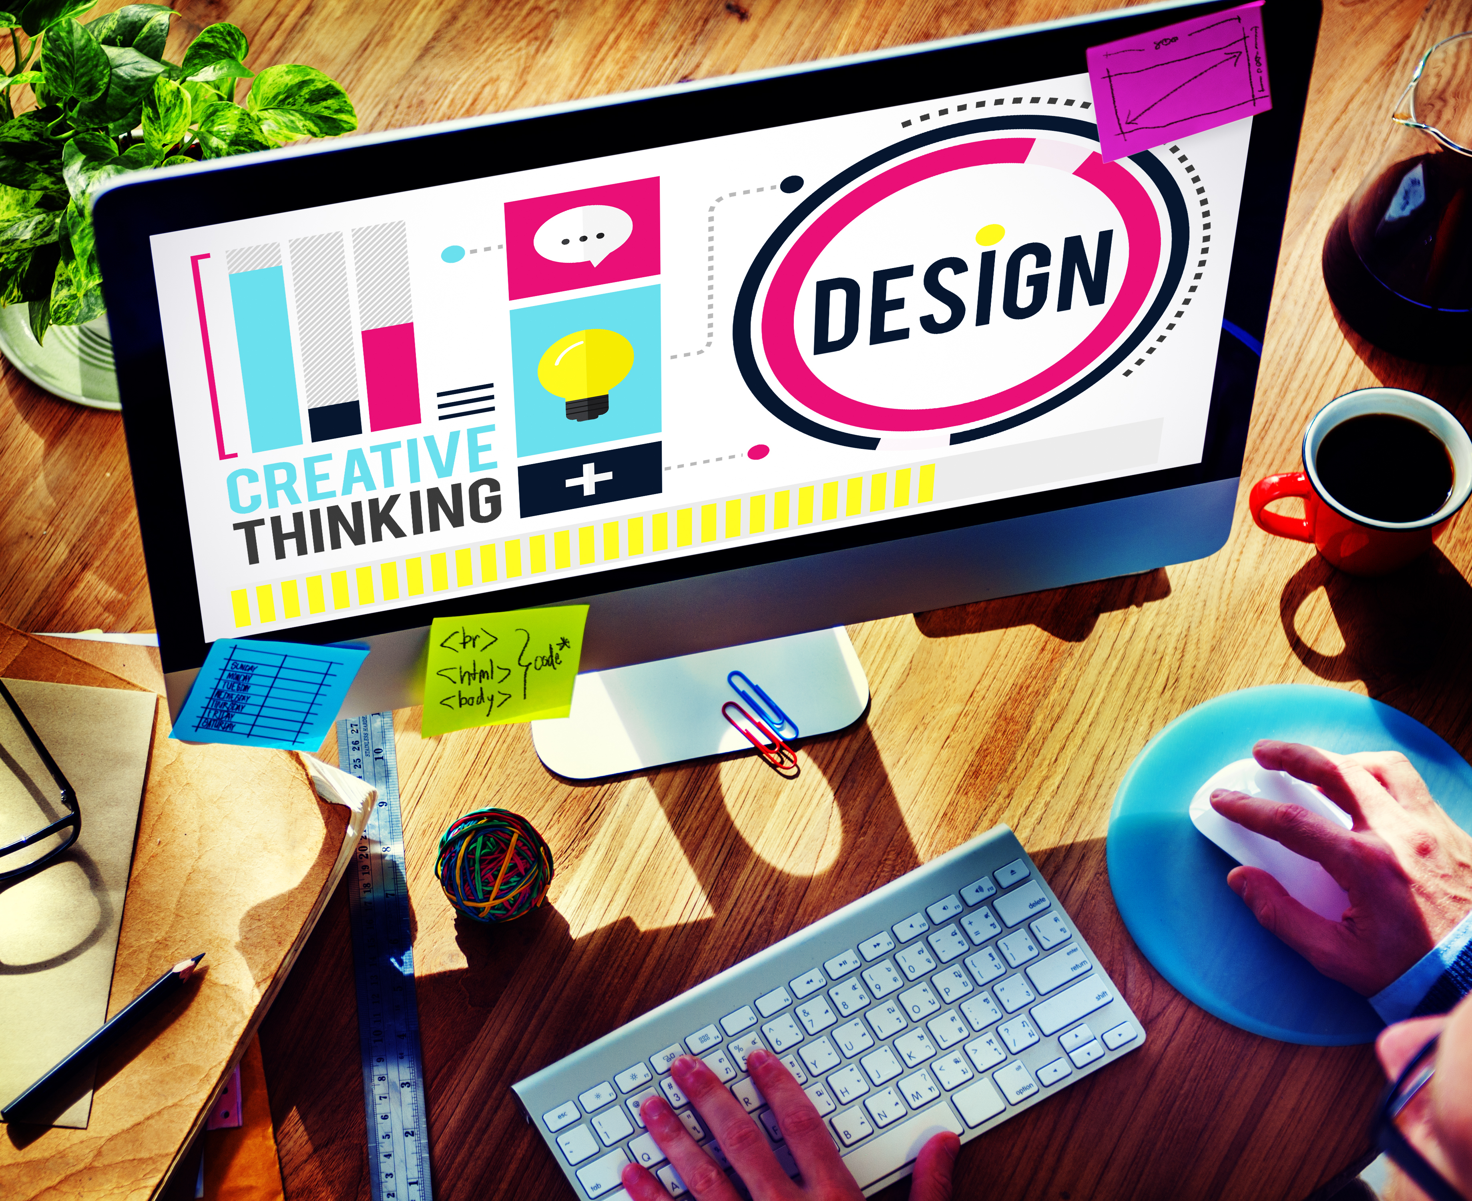
Graphic Design is Emotional Design
You should design with an eye for how elements match the tone. You also need to design for the overall effect, and note how you shape users’ emotions as you guide them.

Slide 9
Different types of graphic design
Visual identity graphic design
A brand is a relationship between a business or organization and its audience. A brand identity is how the organization communicates its personality, tone and essence, as well as memories, emotions and experiences.

Slide 10
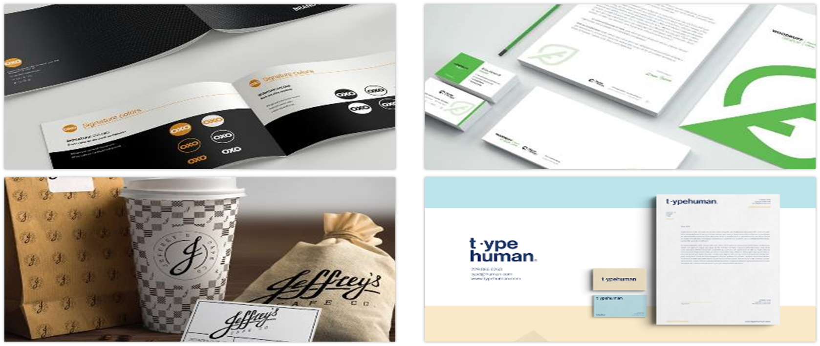
Visual Identity Graphic Design

Slide 11
Different types of graphic design
2. Marketing & advertising graphic design
Great marketing engages people based on the wants, needs, awareness and satisfaction they have about a product, service or brand.

Slide 12
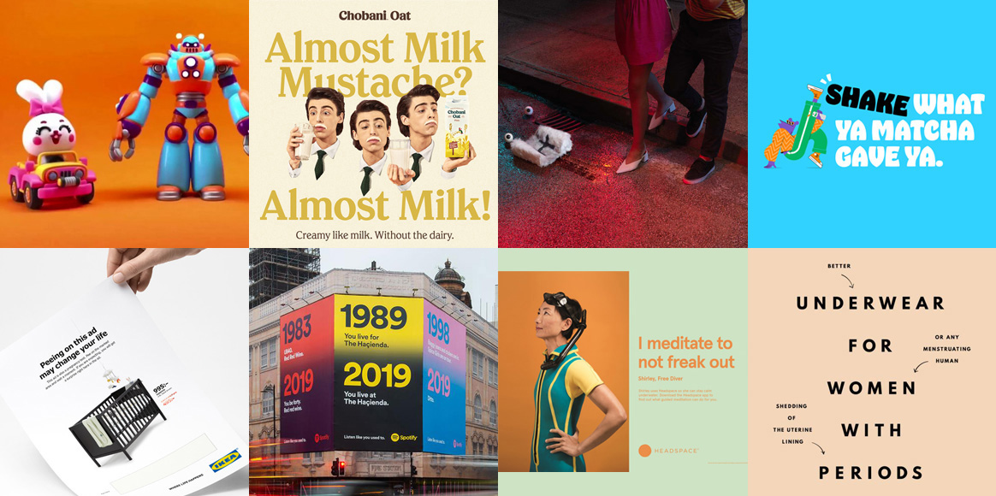
Different types of graphic design

Slide 13
Different types of graphic design
Designers can specialize in a specific type of media (vehicle wraps or magazine ads, for example) or create a broad assortment of collateral for print, digital, and beyond.

Slide 14

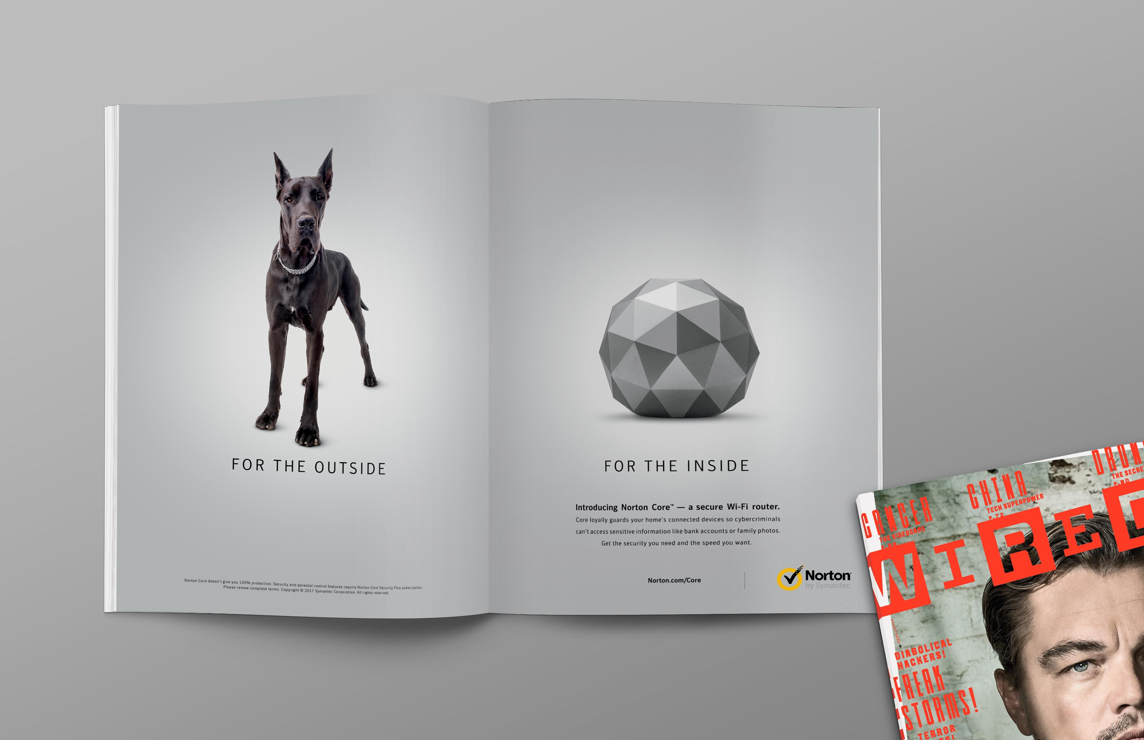
Different types of graphic design

Slide 15
Examples of marketing graphic design
Postcards and flyers
Magazine and newspaper ads
Posters, banners and billboards
Brochures (print and digital)
Vehicle wraps

Slide 16
Examples of marketing graphic design
PowerPoint presentations
Menus
Social media ads, banners and graphics
Banner
Images for websites and blogs

Slide 17


Marketing Graphic Design

Slide 18
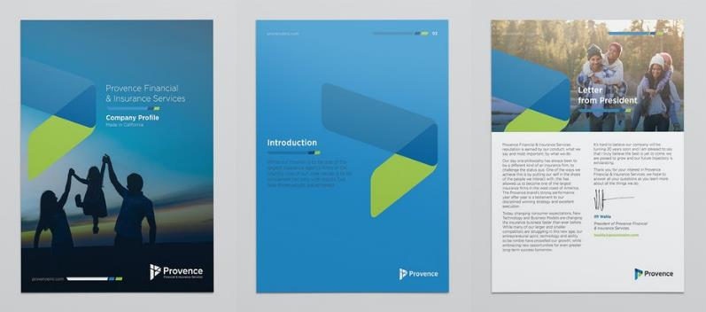
Marketing Graphic Design

Slide 19
Different types of graphic design
3. User interface graphic design
UI design is the process of designing interfaces to make them easy to use and provide a user-friendly experience.

Slide 20
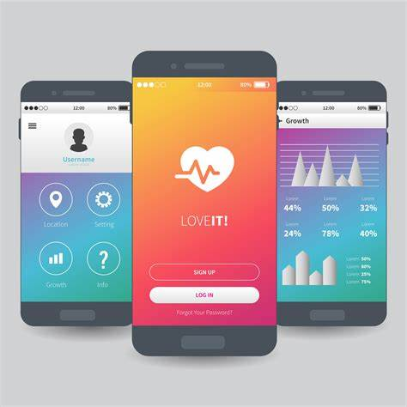
Different types of graphic design
In the context of graphic design, UI design focuses on the user’s visual experience and the design of on-screen graphic elements. It’s a UI designer’s job to balance aesthetic appeal with technical functionality.

Slide 21
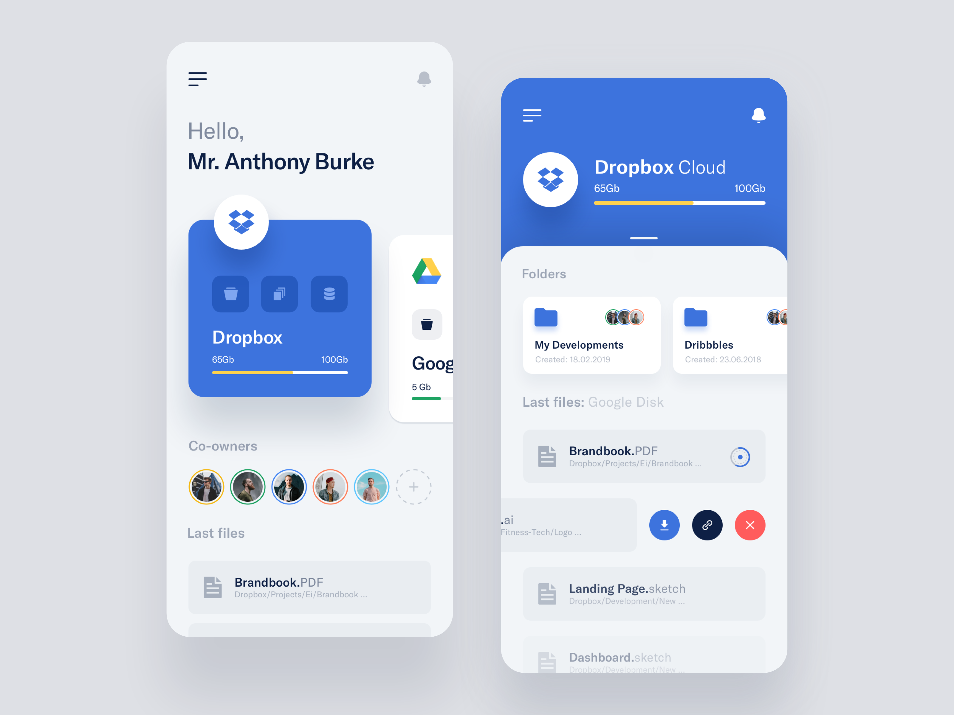
Examples of user interface graphic design
Web page design
Theme design
Game interfaces
App design

Slide 22
For UI Designer
UI designers must be team players backed by both serious graphic design skills and an excellent understanding of UI/UX principles, responsive design and web development.

Slide 23
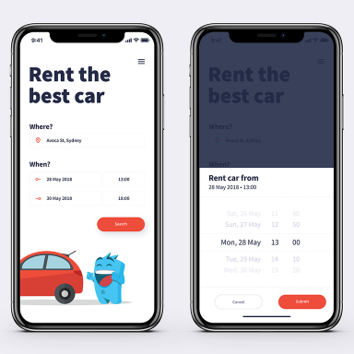
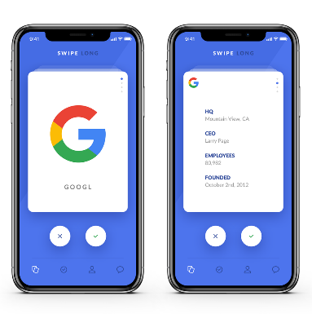
UI

Slide 24
For UI Designer
In addition to graphics apps, they need knowledge of programming languages like HTML, CSS and JavaScript.

Slide 25
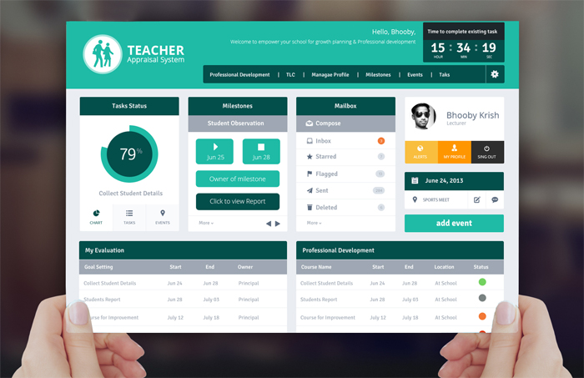
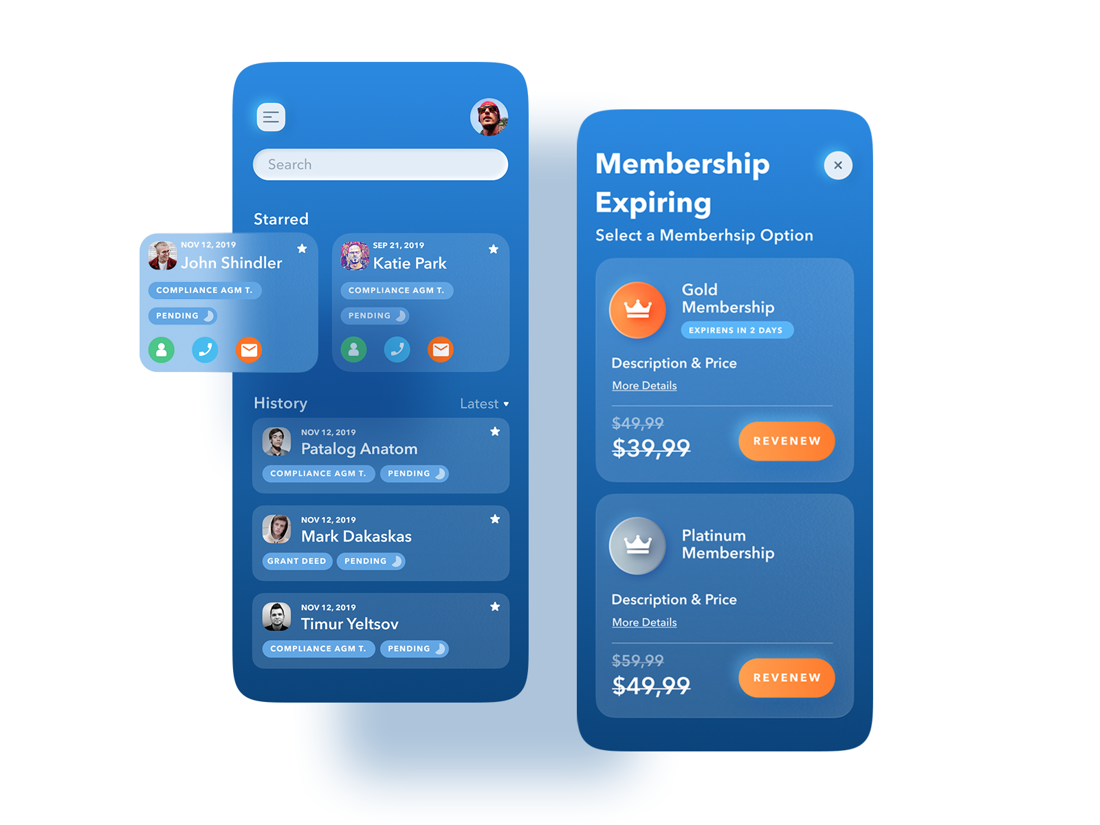
UI

